Slide 1


Shallow vs Deep Copy
MARCUS BIEL,
Software Craftsman
www.marcus-biel.com

Slide 2


What is a Copy in Java?
Shallow Copy
Deep Copy
Without fully understanding the idea of “shallow versus deep”

Slide 3

What is a Copy in Java?
COPY
We can already see that the expression is related to a copy.

Slide 4
What is a Copy in Java?
COPY
So let’s start with the simplest question – What actually is a “copy” in Java?

Slide 5
What is a Copy in Java?
COPY
To answer that question, we have to differentiate between a reference copy and an object copy.

Slide 6
Reference Copy
myCar1
Car Object 1
myCar2
As the name implies, a reference copy creates a copy of a
reference variable pointing to an object.

Slide 7
Reference Copy
myCar1
Car Object 1
myCar2
So we will have two reference variables referencing the same object.

Slide 8
Object Copy
myCar1
Car Object
myCar2
Car Object Copy
On the other hand, an object copy creates a copy of the object itself.

Slide 9
Object Copy
myCar1
Car Object
myCar2
Car Object Copy
So as you can see here, we will have two reference variables
that each reference a different object

Slide 10
Object Copy
myCar1
Car Object
myCar2
Car Object Copy
Shallow and Deep Copy are both related to an object copy.

Slide 11

What is an Object?
Object
But what is an object, actually ?
Often, an object is represented as a single coffee bean.

Slide 12
What is an Object?
Object
However, that’s just a very simplified view. Let’s look at this in more detail.

Slide 13
What is an Object?
Person
Say we have a Person object.

Slide 14
What is an Object?
Person
Name
This Person object is composed of other objects.
Our Person has a Name

Slide 15
What is an Object?
Person
Name
Address
and an Address.

Slide 16
What is an Object?
Person
Name
Address
First Name
The Name object is composed of a FirstName object

Slide 17
What is an Object?
Person
Name
Address
First Name
Last Name
and a LastName object.

Slide 18
Person
Name
Address
First Name
Last Name
Street
The Address object is composed of a Street object

Slide 19
What is an Object?
Person
Name
Address
First Name
Last Name
Street
City
and a City object. So when we say “Person object”,

Slide 20
What is an Object?
Person
Name
Address
First Name
Last Name
Street
City
We are actually referring to this entire network of objects.

Slide 21

Reason to Copy an Object
So why would we want to make an object copy?

Slide 22
Reason to Copy an Object
An object copy, also called a clone, is usually created

Slide 23

Reason to Copy an Object
If we want to modify or move an object, while still preserving the
state of the original object.

Slide 24
Ways to Copy an Object
There are different ways to copy an object, for example by
using a copy constructor or a clone method.

Slide 25
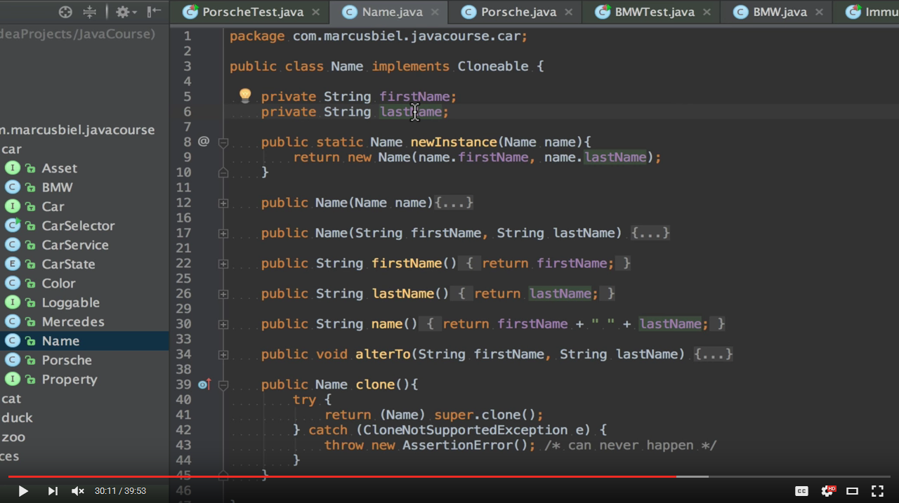
Ways to Copy an Object
http://www.marcus-biel.com/object-clone-method/
In short, I do not recommend that you use the clone
method to copy an object.
For more details, watch my video about the topic.

Slide 26
Ways to Copy an Object
In this episode, we will use a copy constructor to create
both a Shallow and Deep Copy.

Slide 27

Shallow Copy vs. Deep Copy
Shallow Copy
Deep Copy
Now that we have a solid foundation, let me explain the actual difference between a “Shallow” and a “Deep Copy” of an object.

Slide 28
Shallow Copy
Shallow Copy
Let’s start with a Shallow Copy.

Slide 29
Shallow Copy
Person
Name
Address
First Name
Last Name
Street
City
Here you can see the object structure of our Person object again.

Slide 30
Shallow Copy
Person
Person
Name
Address
First Name
Last Name
Street
City
To create a Shallow Copy, we only copy the “main” object, Person.

Slide 31
Shallow Copy
Person
Person
Name
Address
First Name
Last Name
Street
City
So a Shallow Copy references
the same inner objects as the original Person.

Slide 32
Shallow Copy
Person
Person
Name
Address
First Name
Last Name
Street
City
Therefore,
a Shallow Copy and its source are closely related to each other.

Slide 33
Shallow Copy
Person
Person
Name
Address
First Name
Last Name
Street
City
As an example,
a change to the Address object will reflect in both Persons.

Slide 34
Shallow Copy
Person
Person
Name
Address
First Name
Last Name
Street
City
This is a problem if you need two truly independent Person objects.

Slide 35
Deep Copy
Deep Copy
In contrast to a Shallow Copy,
a Deep Copy is a fully independent copy of an object.

Slide 36
Deep Copy
Person
Name
Address
First Name
Last Name
Street
City
So we start again with our Person object.

Slide 37
Deep Copy
Person
Person
Name
Address
Name
Address
First Name
Last Name
Street
City
First Name
Last Name
Street
City
But this time, we copy the entire object structure.

Slide 38
Deep Copy
Person
Person
Name
Address
Name
Address
First Name
Last Name
Street
City
First Name
Last Name
Street
City
Now both Person objects can be changed independently.

Slide 39
Deep Copy
Person
Person
Name
Address
Name
Address
First Name
Last Name
Street
City
First Name
Last Name
Street
City
A change in one of the Address objects
would not be reflected in the other Person’s Address.

Slide 40
A Mixed Approach
Person
Person
Name
Address
Address
First Name
Last Name
Street
City
First Name
Last Name
Finally, a combination of a Shallow and a Deep Copy is also possible.
Fields that need to be changed will be deep copies.

Slide 41
A Mixed Approach
Person
Person
Name
Address
Address
First Name
Last Name
Street
City
First Name
Last Name
All other fields will be shared.

Slide 42
A Mixed Approach
Person
Person
Name
Address
Address
First Name
Last Name
Street
City
First Name
Last Name
Okay, I think we’ve had enough of the circles - let’s just see the code!

Slide 43
Shallow Copy
Shallow Copy
Just like before, we’ll start with a Shallow Copy.

Slide 44
Shallow Copy
public class Person {
private Name name;
private Address address;
public Person(Person originalPerson) {
this.name = originalPerson.name;
this.address = originalPerson.address;
}
[…]
}
So we have a class Person, which internally uses a Name and an Address.
The copy constructor takes the original Person object and copies
its reference variables.

Slide 45
Shallow Copy
Person mother = new Person(new Name(…), new Address(…));
Okay, now that we have seen the code of the Person class, let’s actually
make use of it. First, we create a Person object, called “mother”, with a Name and an Address.

Slide 46
Shallow Copy
Person mother = new Person(new Name(…), new Address(…));
[…]
Person son = new Person(mother);
Somewhere later in the code, we will create a copy of this Person object and assign this copy to the reference variable “son”.

Slide 47
Shallow Copy
Person mother = new Person(new Name(…), new Address(…));
[…]
Person son = new Person(mother);
The Mother object will be taken as a basis for the Son object,
as they will both share the same address.

Slide 48
Shallow Copy
Person mother = new Person(new Name(…), new Address(…));
[…]
Person son = new Person(mother);
[…] son.moveOut(new Street(…), new City(…));
Much later, when the son has grown old enough to support himself, he wants to move out - only to find out that his mommy has joined him.

Slide 49
Shallow Copy
Person mother = new Person(new Name(…), new Address(…));
[…]
Person son = new Person(mother);
[…] son.moveOut(new Street(…), new City(…));
To better understand what actually happened, let’s revisit the code.

Slide 50
Shallow Copy
Person mother = new Person(new Name(…), new Address(…));
[…]
Person son = new Person(mother);
[…] son.moveOut(new Street(…), new City(…));
Can you figure out what’s wrong?
Think about it for a moment.

Slide 51
Shallow Copy
Person mother = new Person(new Name(…), new Address(…));
[…]
Person son = new Person(mother);
[…] son.moveOut(new Street(…), new City(…));
Okay, so, the issue is that in the moveOut method, we directly changed our internal address object by replacing its Street and City objects.

Slide 52
Shallow Copy
Person mother = new Person(new Name(…), new Address(…));
[…]
Person son = new Person(mother);
[…] son.moveOut(new Street(…), new City(…));
Because the address object is shared with our mother object,
the change reflected in both Person objects.

Slide 53
Shallow Copy
Person mother = new Person(new Name(…), new Address(…));
[…]
Person son = new Person(mother);
[…] son.moveOut(new Address(…));
To fix the issue, we could simply assign a new Address object to son.
Just for the record, however, please note that our son object wouldn't be a true shallow copy anymore.

Slide 54
Shallow Copy
Person mother = new Person(new Name(…), new Address(…));
[…]
Person son = new Person(mother);
[…] son.moveOut(new Address(…));
In conclusion, if used correctly, a Shallow Copy may be fine,
but it could also lead to unexpected behaviour.

Slide 55
Deep Copy
Deep Copy
Last but not least,
let’s look at the code used to create a Deep Copy of the Person object.

Slide 56
Deep Copy
public class Person {
private Name name;
private Address address;
public Person(Person otherPerson) {
this.name = new Name(otherPerson.name);
this.address = new Address(otherPerson.address);
}
[…]
}
Again, we use a copy constructor,
but this time we will create a Deep Copy of the object.

Slide 57
Deep Copy
public class Person {
private Name name;
private Address address;
public Person(Person otherPerson) {
this.name = new Name(otherPerson.name);
this.address = new Address(otherPerson.address);
}
[…]
}
So we create two instances of Name and Address by using yet more copy constructors. But actually that’s not the end of the story.

Slide 58
Deep Copy
public class Person {
private Name name;
private Address address;
public Person(Person otherPerson) {
this.name = new Name(otherPerson.name);
this.address = new Address(otherPerson.address);
}
[…]
}
For a true Deep Copy, we have to continue copying all of the object’s nested elements, until there are only primitive types or so called “Immutables” left.

Slide 59
Deep Copy
public class Street {
private String name;
private int number;
public Street(Street otherStreet){
this.name = otherStreet.name;
this.number = otherStreet.number;
}
[…]
}
Let’s look at the Street class to better illustrate this. The Street class consists of two instance variables -

Slide 60
Deep Copy
public class Street {
private String name;
private int number;
public Street(Street otherStreet){
this.name = otherStreet.name;
this.number = otherStreet.number;
}
[…]
}
…. String name and int number. Let’s look at the int number first:

Slide 61
Deep Copy
public class Street {
private String name;
private int number;
public Street(Street otherStreet){
this.name = otherStreet.name;
this.number = otherStreet.number;
}
[…]
}
It is a primitive value and not an object. It has no reference variable.
It’s just a simple value that can never be shared.

Slide 62
Deep Copy
public class Street {
private String name;
private int number;
public Street(Street otherStreet){
this.name = otherStreet.name;
this.number = otherStreet.number;
}
[…]
}
So when in the copy constructor we say “this dot number equals otherStreet dot number”, we are automatically receiving a copy of the value.

Slide 63
Deep Copy
public class Street {
private String name;
private int number;
public Street(Street otherStreet){
this.name = otherStreet.name;
this.number = otherStreet.number;
}
[…]
}
The other instance variable, “name” is an object of type String.
However, String is an Immutable.

Slide 64
Deep Copy
public class Street {
private String name;
private int number;
public Street(Street otherStreet){
this.name = otherStreet.name;
this.number = otherStreet.number;
}
[…]
}
In short, an Immutable is an object, that,
once created, can never be changed again.

Slide 65
Deep Copy
public class Street {
private String name;
private int number;
public Street(Street otherStreet){
this.name = otherStreet.name;
this.number = otherStreet.number;
}
[…]
}
Therefore, you can share it without having to create a Deep Copy of it.

Slide 66
Deep Copy
Person mother = new Person(new Name(…), new Address(…));
[…]
Person son = new Person(mother);
[…] son.moveOut(new Street(…), new City(…));
Now that we’re using a Deep Copy,
the son can successfully move out! Hooray!

Slide 67
Deep Copy
Person mother = new Person(new Name(…), new Address(…));
[…]
Person son = new Person(mother);
[…] son.moveOut(new Street(…), new City(…));
However, as a final note of caution, please note that just because a Deep Copy lets you get away with this, don’t infer that I suggest you do so.

Slide 68
Deep Copy
Person mother = new Person(new Name(…), new Address(…));
[…]
Person son = new Person(mother);
[…] son.moveOut(new Street(…), new City(…));
Directly changing the internal details of
an object is bad code style and should generally be avoided.

Slide 69
Deep Copy
Person mother = new Person(new Name(…), new Address(…));
[…]
Person son = new Person(mother);
[…] son.moveOut(new Address(…));
In our example,
I would recommend using a new Address object instead.

Slide 70
Thank You
Copyright © 2016 Marcus Biel All rights reserved

